Slide 1

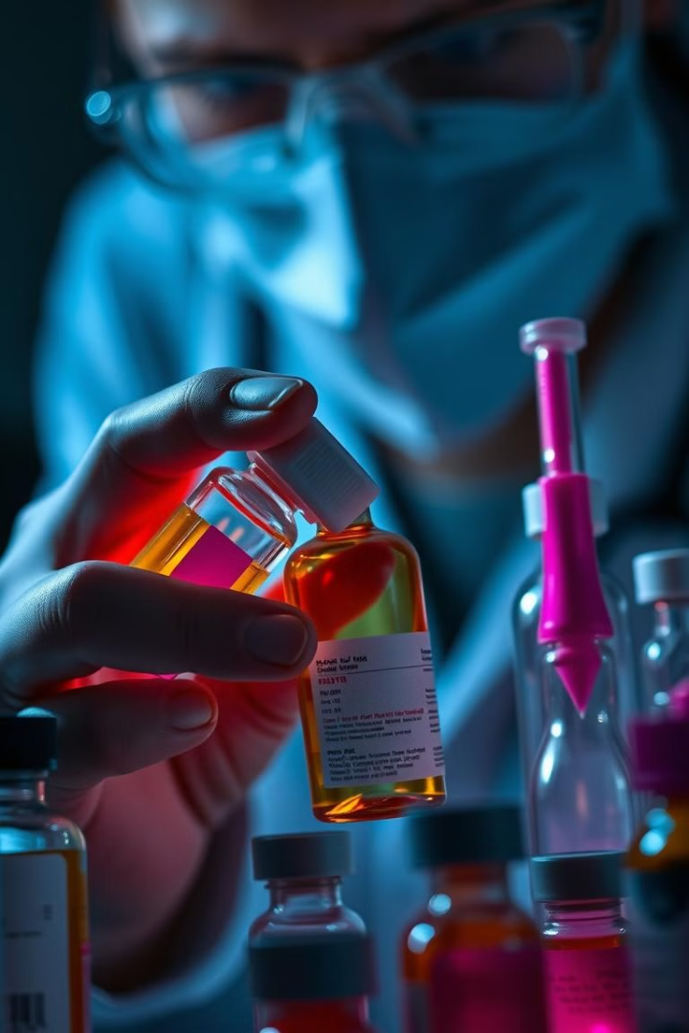

Tackling Counterfeit Drugs with Blockchain
Counterfeit drugs pose a significant threat to public health. They can lead to ineffective treatments, adverse health outcomes, and even fatalities. This project proposes a blockchain-based solution to enhance transparency and traceability within the pharmaceutical supply chain, ensuring the authenticity of drugs from production to sale.
I1
by IOMP TEAM 12
Notes:
can i add

Slide 2
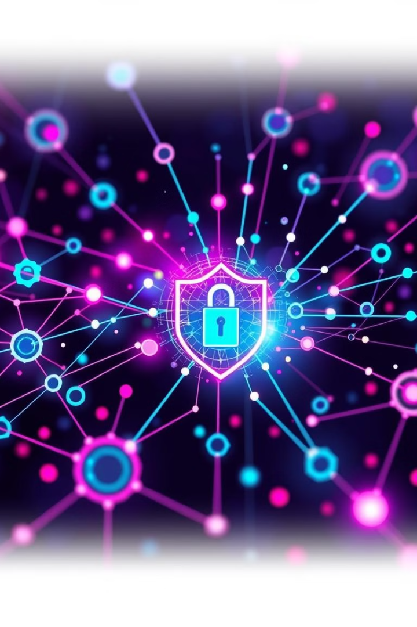
Key Features
1
Secure Record Keeping
2
Real-Time Visibility
Each drug's journey is permanently recorded on the blockchain, ensuring transparency and preventing data tampering.
The system allows you to track drug movement across the supply chain in real-time, providing instant accountability.
3
Authenticity Verification
4
Automated Processes
Each drug receives a unique digital signature, verifiable on the blockchain, confirming its origin and legitimacy.
Smart contracts handle efficient and trustworthy product release and payment workflows.

Slide 3

Feature 1: Secure Recordkeeping
Immutability
Transparency
Auditability
Once recorded on the blockchain, data cannot be altered or deleted, ensuring a tamper-proof history of drug movement.
All participants in the supply chain can access the immutable record, promoting trust and collaboration.
The blockchain provides a complete and verifiable audit trail of all transactions and activities, enabling thorough investigations.

Slide 4
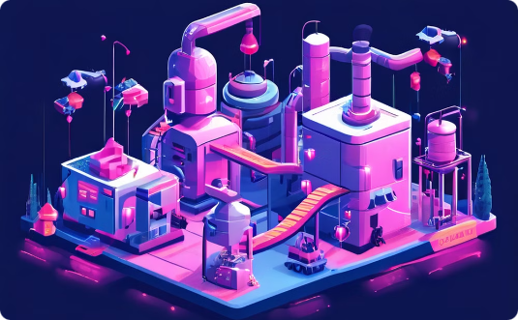
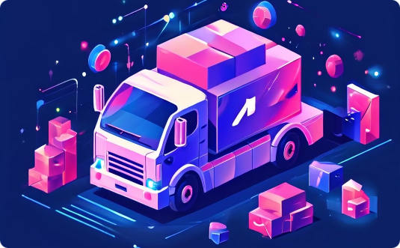
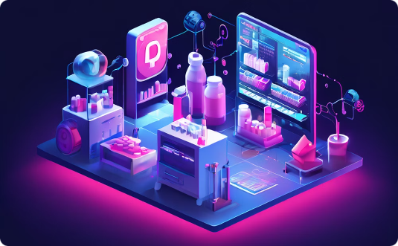
Feature 2: Real-time Tracking
Manufacturing
Distribution
Retail
Each drug batch is registered on the blockchain, including its unique ID, origin, and production date.
Every drug shipment and transfer is recorded on the blockchain, tracking its location and time of movement.
Pharmacies and dispensaries can verify the drug's authenticity and origin before dispensing it to patients.

Slide 5

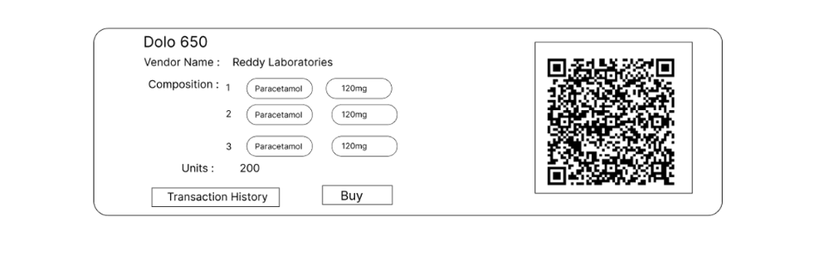
Feature 3: Verifying Drug Authenticity
Our blockchain-based solution assigns a unique digital certificate to every pharmaceutical product, linked to its entire journey from manufacturing to distribution. Customers can validate the origin and integrity of each drug by scanning the QR code on the packaging with our mobile app. The app accesses the blockchain to verify the certificate's authenticity and provides real-time information about the drug's history, ensuring transparency and trust in the supply chain. This robust authentication mechanism effectively eliminates counterfeit drugs, empowering both consumers and healthcare professionals.

Slide 6

Proposed Blockchain-Based Solution
Smart Contracts
Tokenization
Automated agreements and processes are defined on the blockchain, streamlining supply chain operations.
Each drug is assigned a unique digital token representing its identity and journey on the blockchain.
Decentralized Ledger
The blockchain serves as a distributed ledger, eliminating single points of failure and enhancing data integrity.

Slide 7
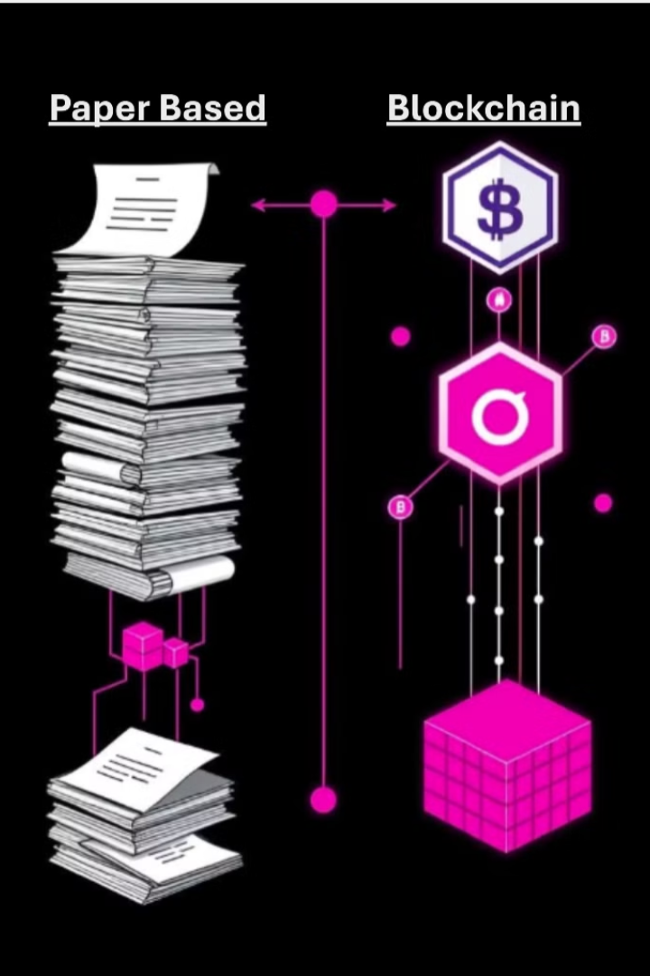
Existing Systems: Disadvantages
Centralized Databases
Vulnerable to data breaches and manipulation
Paper-based Records
Susceptible to counterfeiting, forgery, and loss
Manual Processes
Time-consuming, prone to errors, and lack transparency

Slide 8

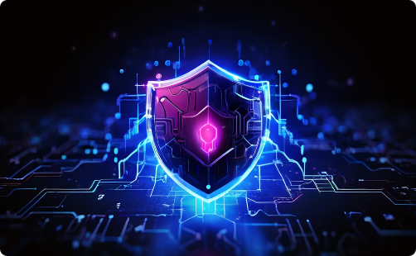

Advantages of the Proposed System
Increased Transparency
Enhanced Security
Improved Efficiency
Blockchain technology provides increased transparency throughout the supply chain. All transactions are recorded on a distributed, tamper-resistant ledger that is visible to all participants. This allows for real-time tracking and tracing of products, enhancing accountability and reducing the risk of counterfeit goods.
Blockchain's decentralized architecture and cryptographic security features help protect against data breaches and unauthorized access. Each block in the chain is secured through complex algorithms, making it extremely difficult to alter or forge records.
Blockchain-based systems automate many manual processes, streamlining operations and reducing the potential for human error. Smart contracts can self-execute based on predefined conditions, improving speed and reliability throughout the supply chain.
All participants have access to the same immutable record, fostering trust and collaboration.

Slide 9
Workflow
Manufacturers
Consumers
Drug Production & Blockchain Entry
Purchase & Authentication
Transfer to Sellers
Consumer Feedback & Finalization
1
2
3
Sellers
Drug Verification
Sales & Record on Blockchain

Slide 10
Benefits of the Blockchain-Based Solution
1
Safer Medications
Reduced risk of counterfeit drugs reaching patients, ensuring the efficacy and safety of prescribed treatments.
2
Reduced Counterfeiting
The blockchain's immutability and transparency make it difficult to create and distribute counterfeit drugs.
3
Improved Patient Outcomes
Patients receive authentic medications, leading to better treatment outcomes and increased confidence in healthcare systems.

Slide 11
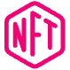



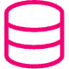
Technical Stack
Blockchain
React.js
TailwindCSS
Ethereum blockchain is used as the foundation for secure and transparent data storage.
A JavaScript library for building dynamic and interactive user interfaces.
A utility-first CSS framework for rapid and efficient web design.
Node.js
MongoDB
A JavaScript runtime environment for building server-side applications.
A NoSQL database for flexible and scalable data management.

